Slide 1


BlackRock Investment Analysis
Weekly status report 4

Slide 2
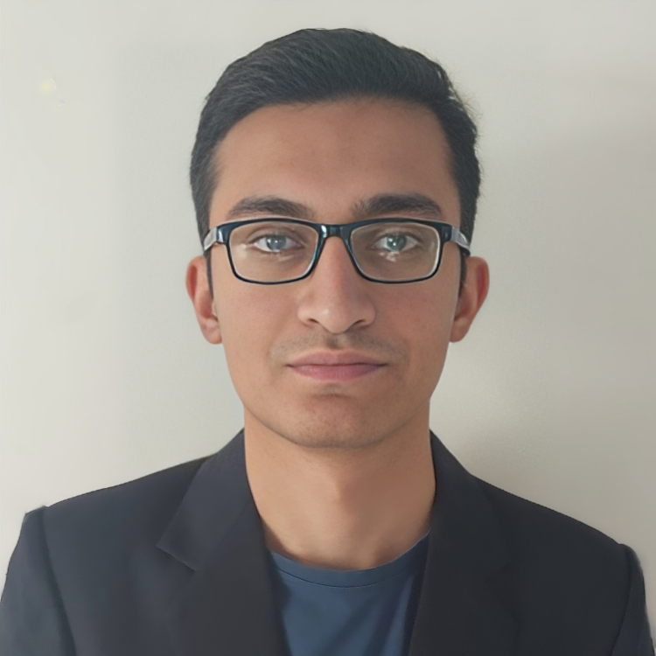
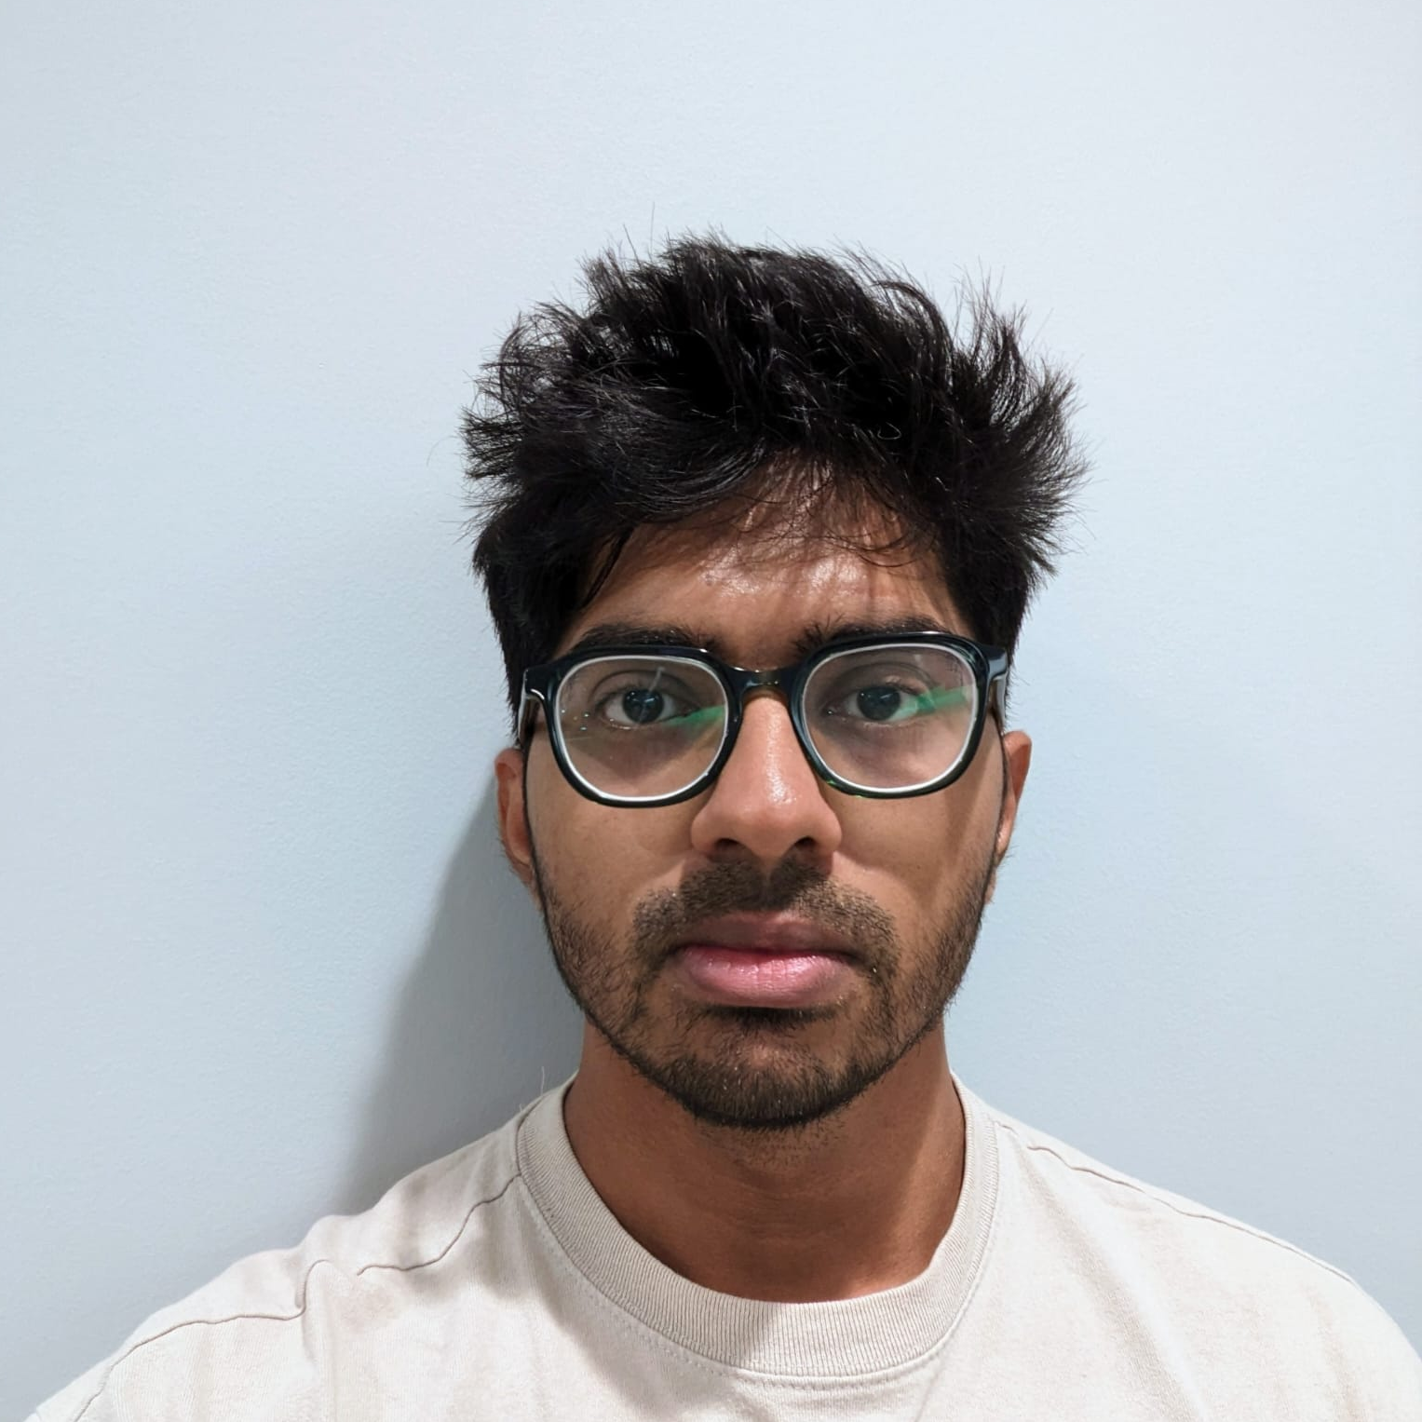

Team Members
Aryan Radadiya
Developer
Joyson Gonsalves
Team Lead
Sumit Kumar Pandey
Data Analyst

Slide 3
Date of Report: 6th February 2024
Date of Last Report: 30th January 2024
Prepared By: Group 7
Project Status: On Track

Slide 4

Activities Since Last Report
Issues or Challenges encountered this week:
Researching for the data model to perform.
What was done to overcome them:
We have researched different models and are planning to test some of them.

Slide 5
Activities Since Last Report
Task completed this week:
Completed data transformation.
Performed Exploratory Data Analysis (EDA) on the data.

Slide 6
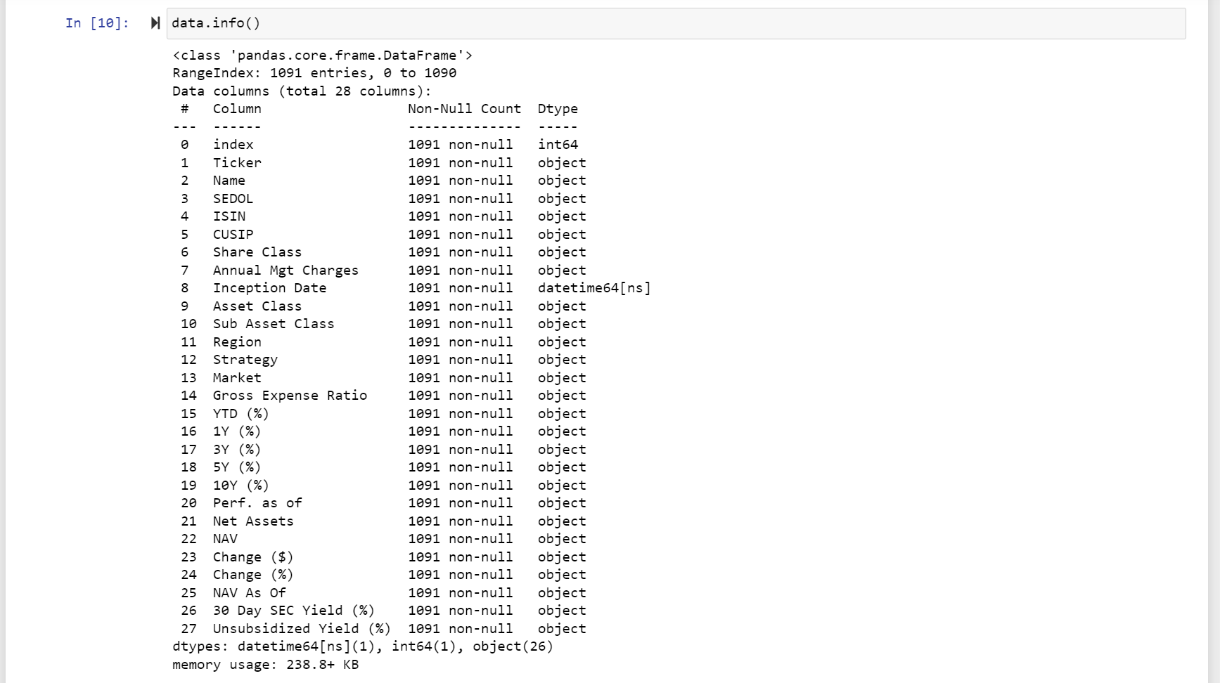
Screenshots of Activities

Slide 7
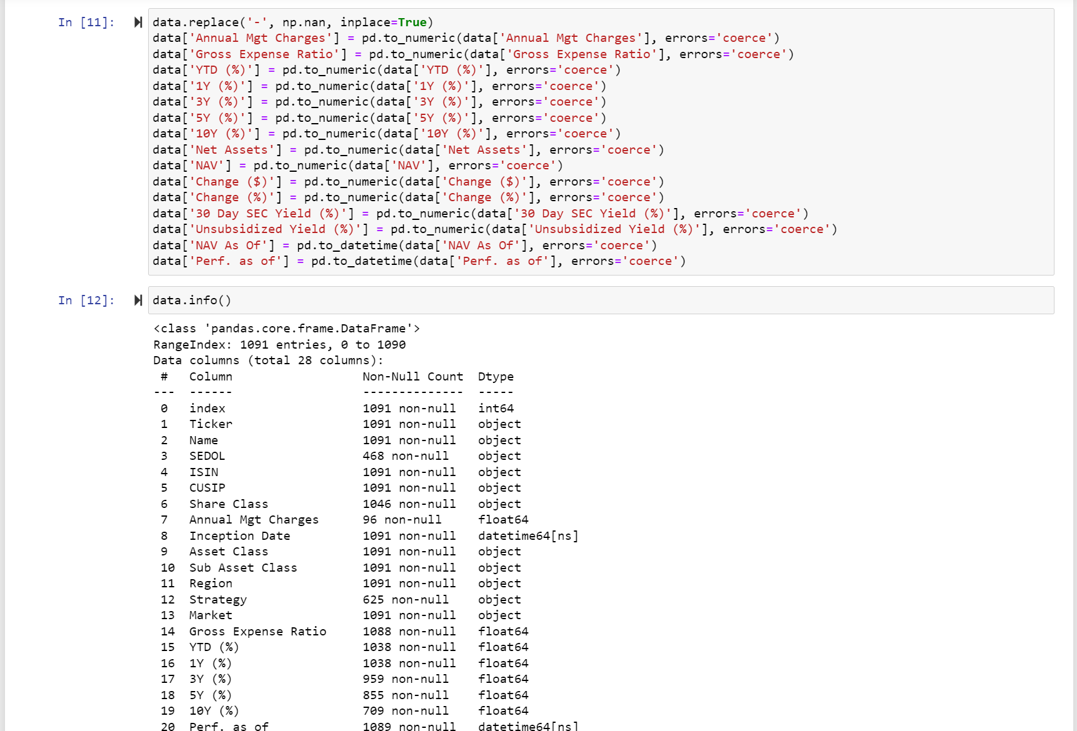
Screenshots of Activities

Slide 8
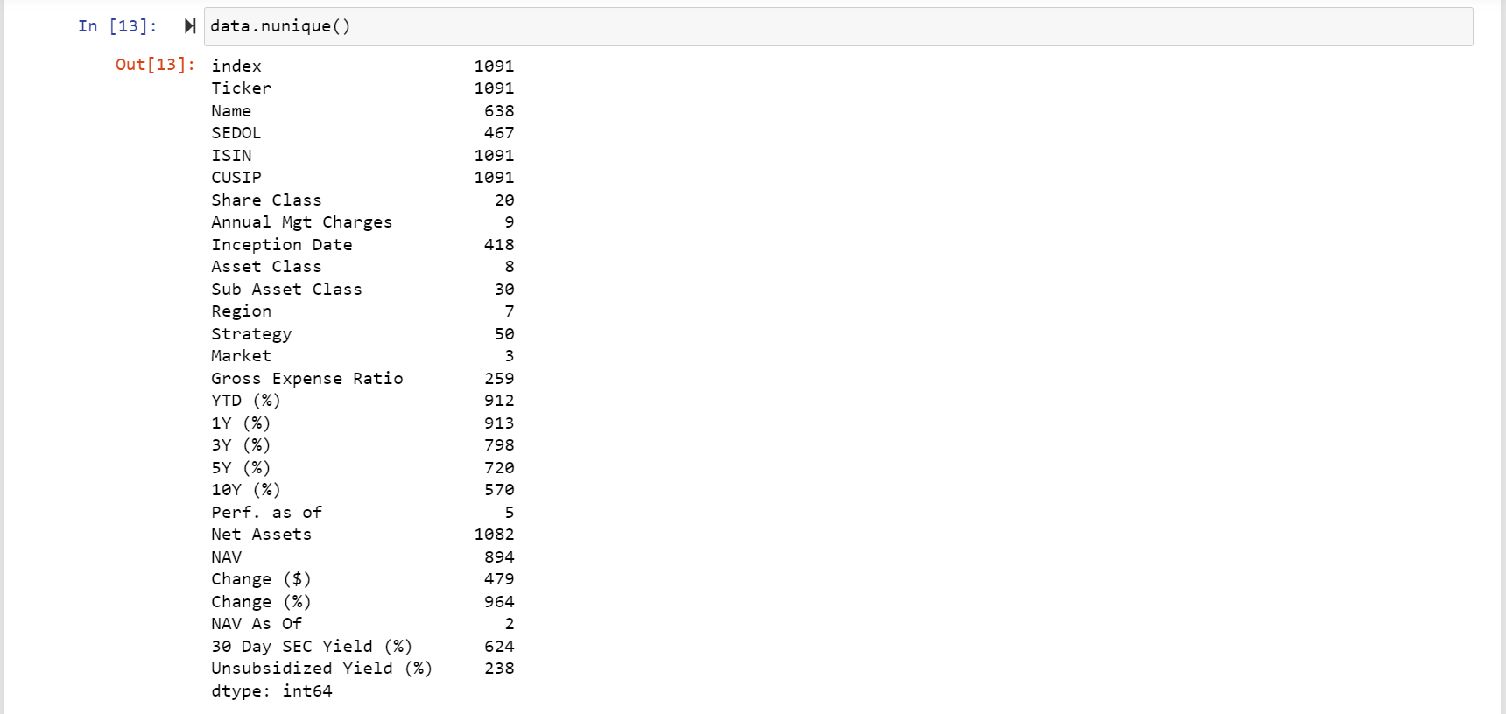
Screenshots of Activities

Slide 9
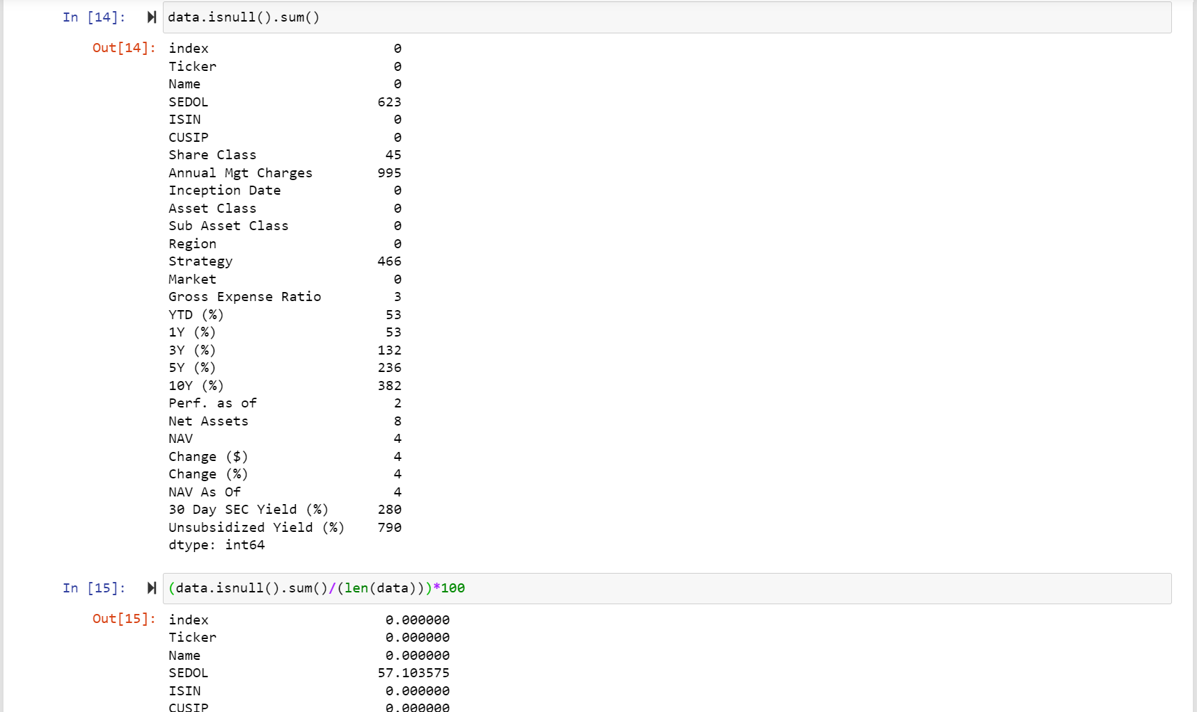
Screenshots of Activities

Slide 10
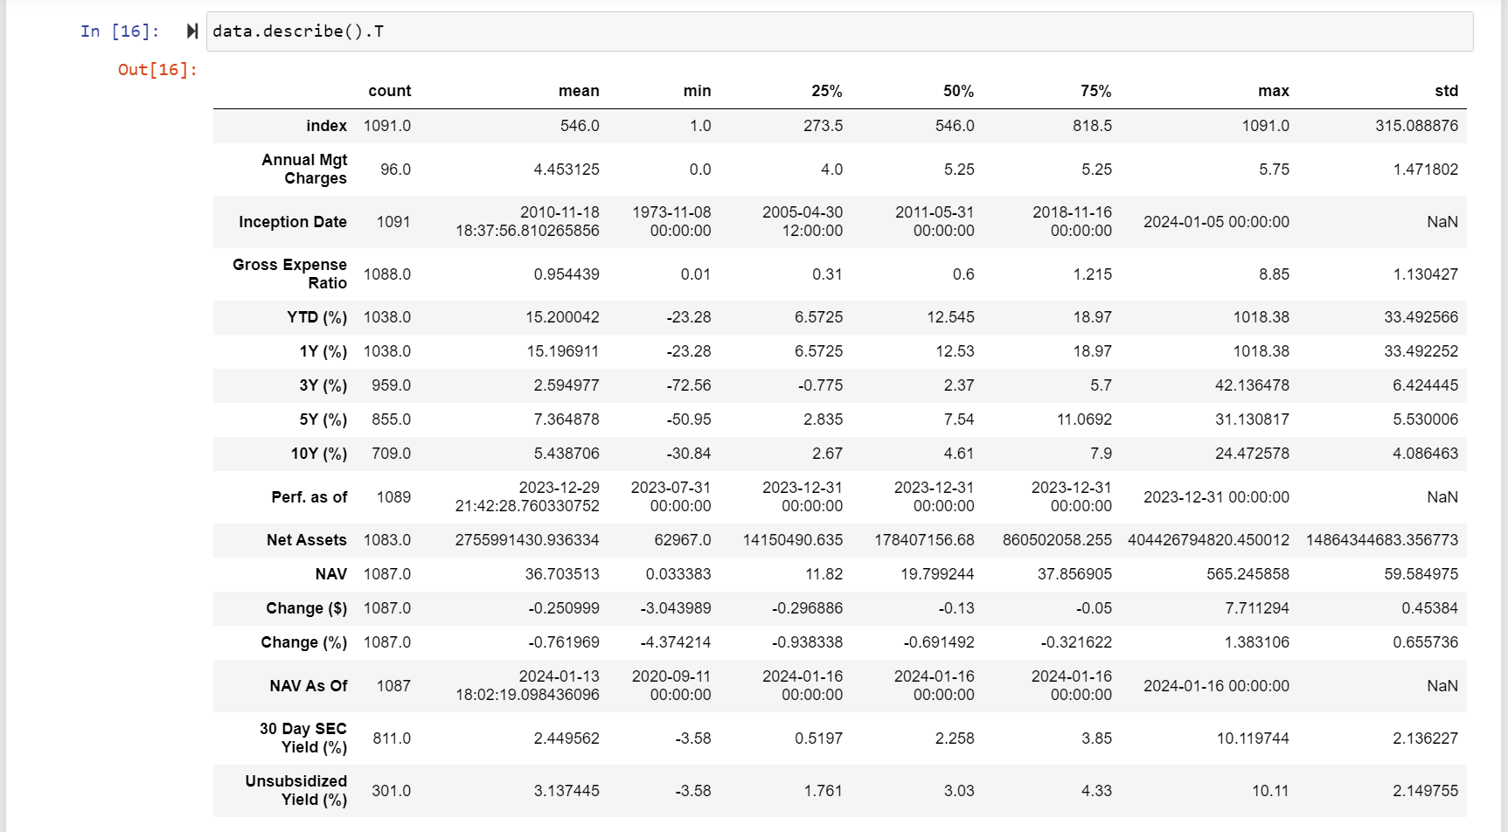
Screenshots of Activities

Slide 11
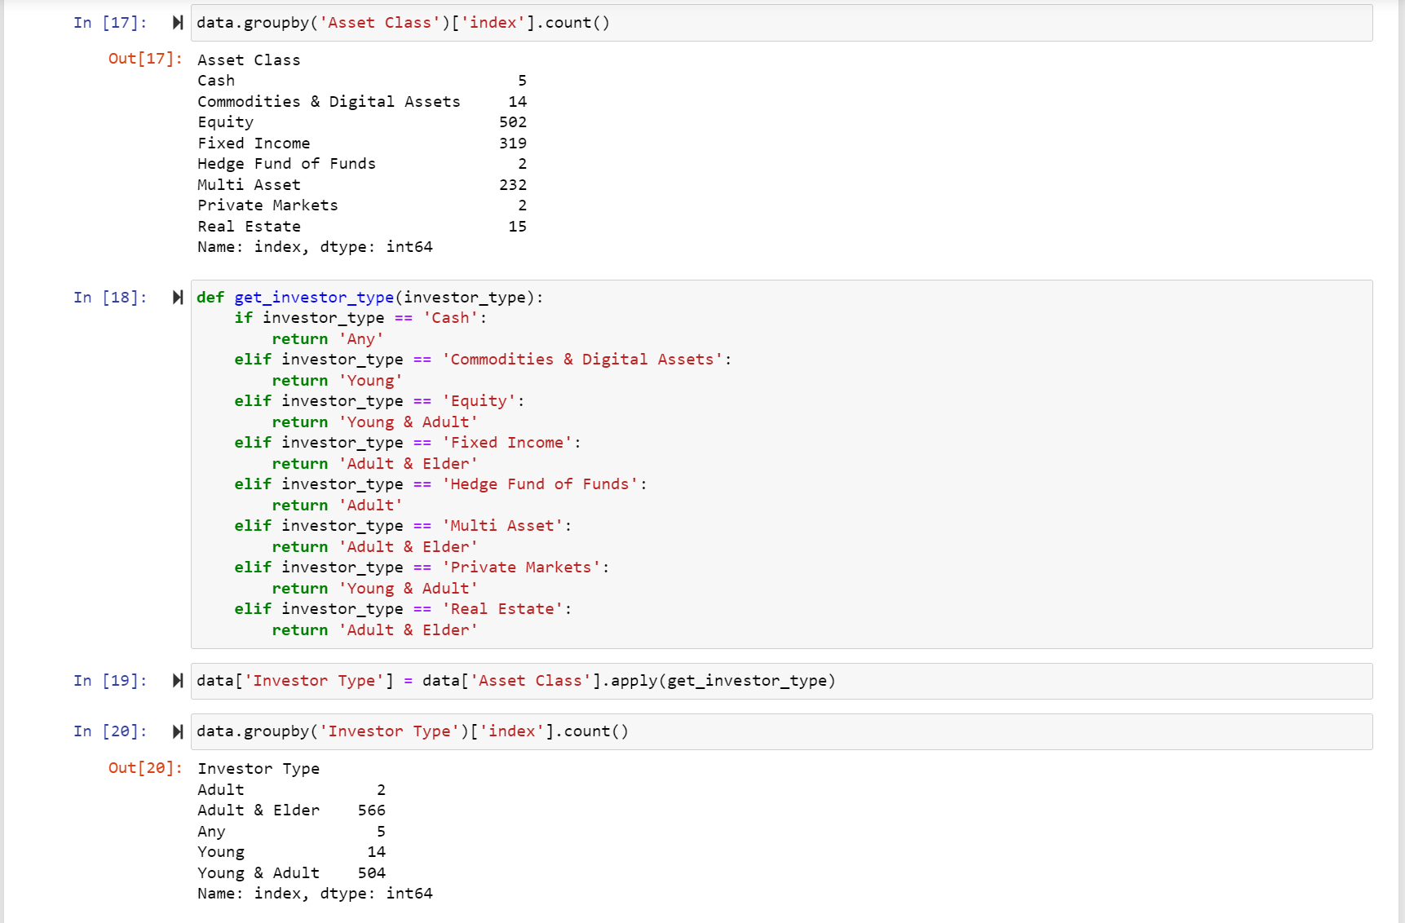
Screenshots of Activities

Slide 12
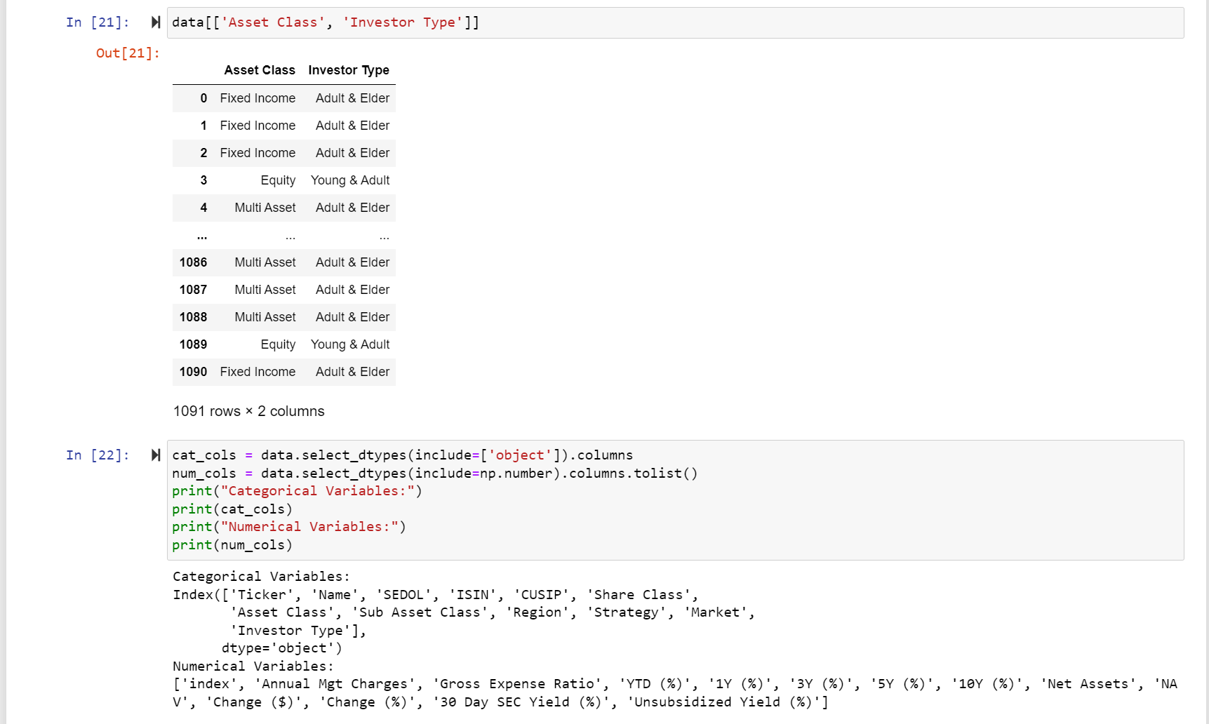
Screenshots of Activities

Slide 13
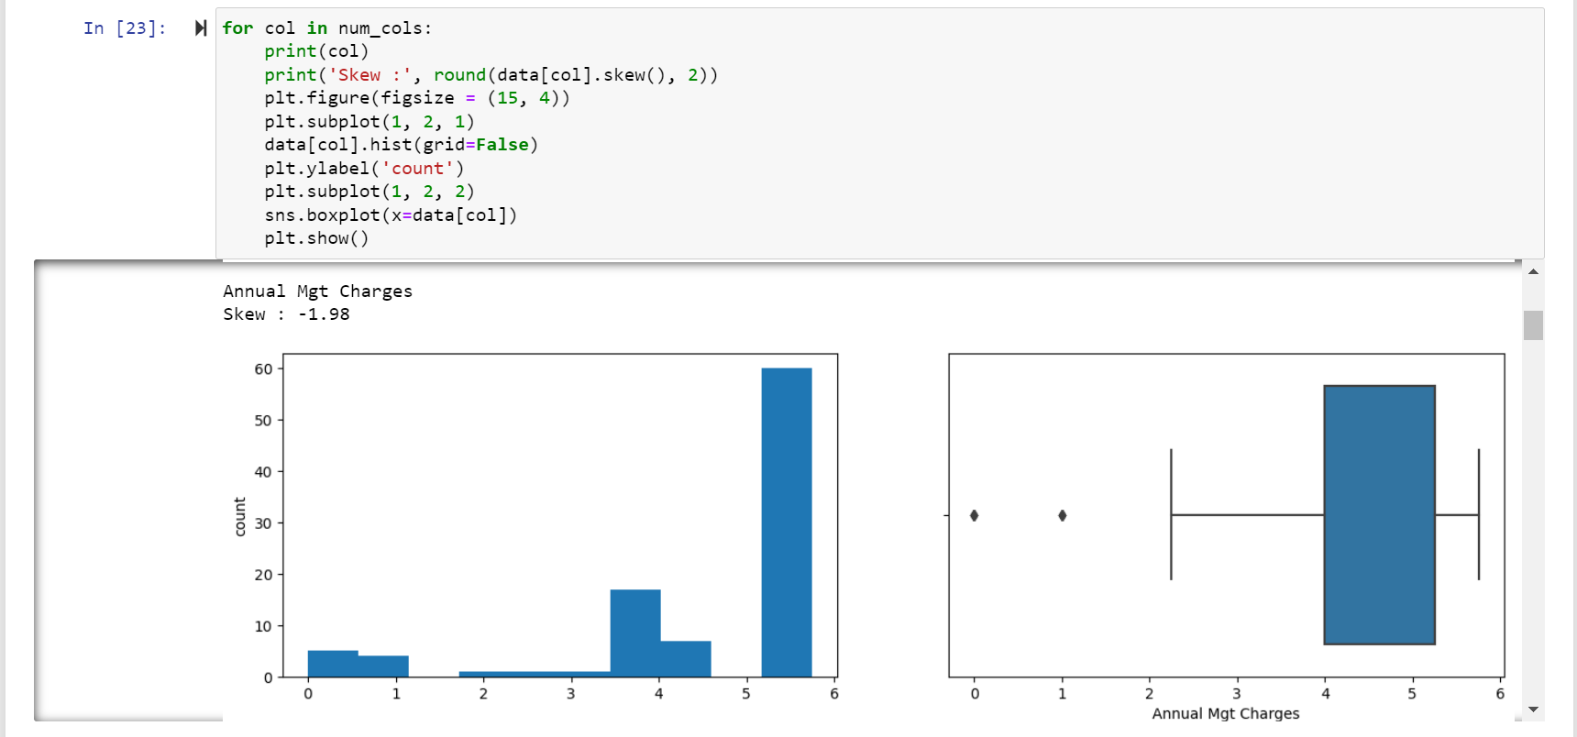
Screenshots of Activities

Slide 14
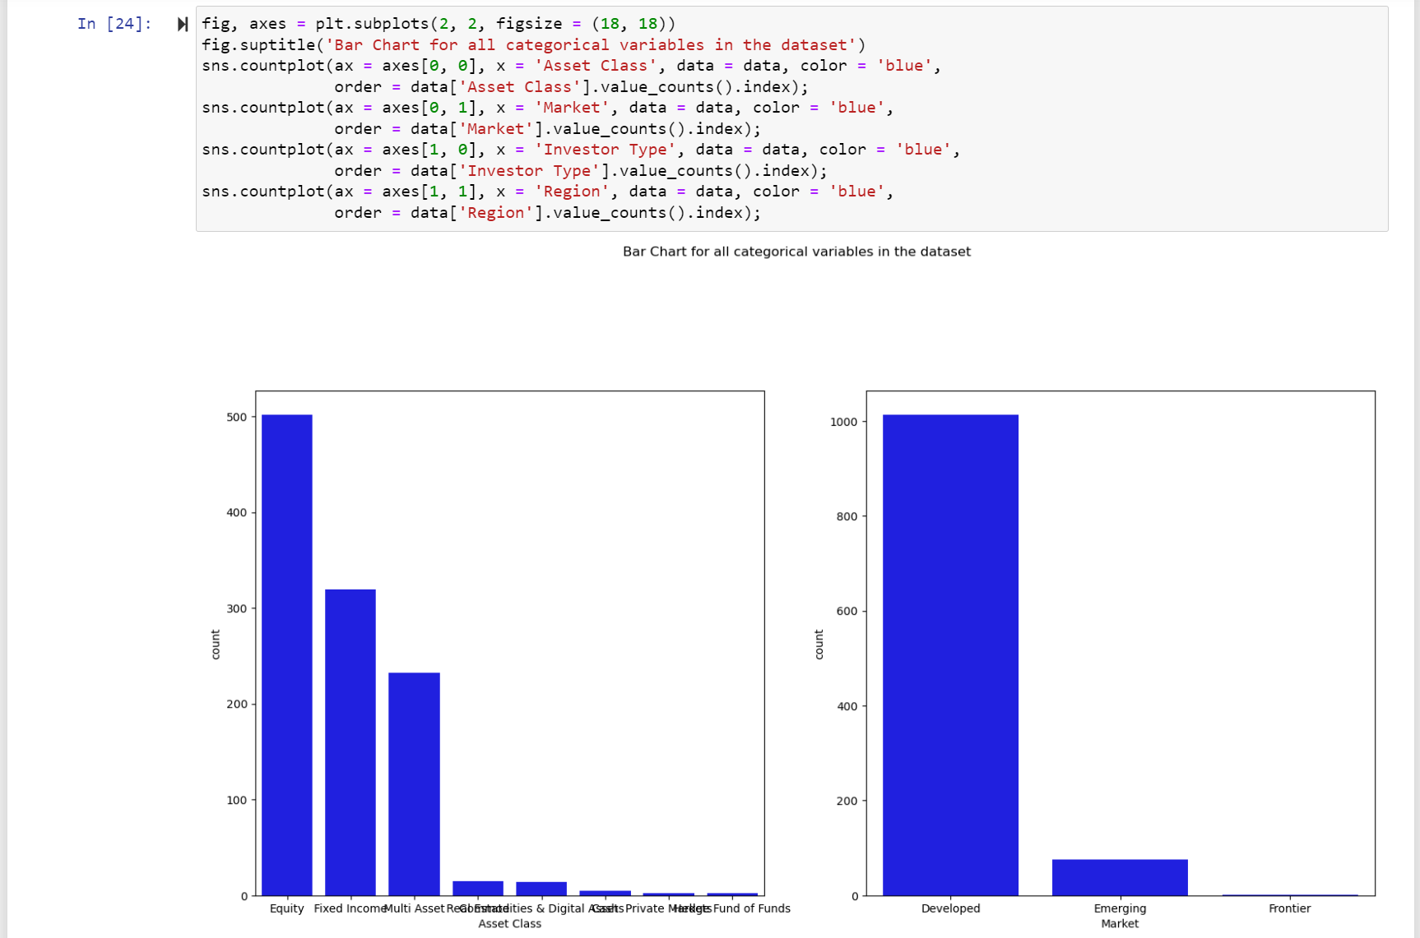
Screenshots of Activities

Slide 15



Communication
We had a phone conversation regarding the project progress and how we are going to proceed.

Slide 16

Activities to be completed before next week
Start to test the data models on the data.
Planning Visualization

Slide 17


Thank You Any Questions?

